Slide 1
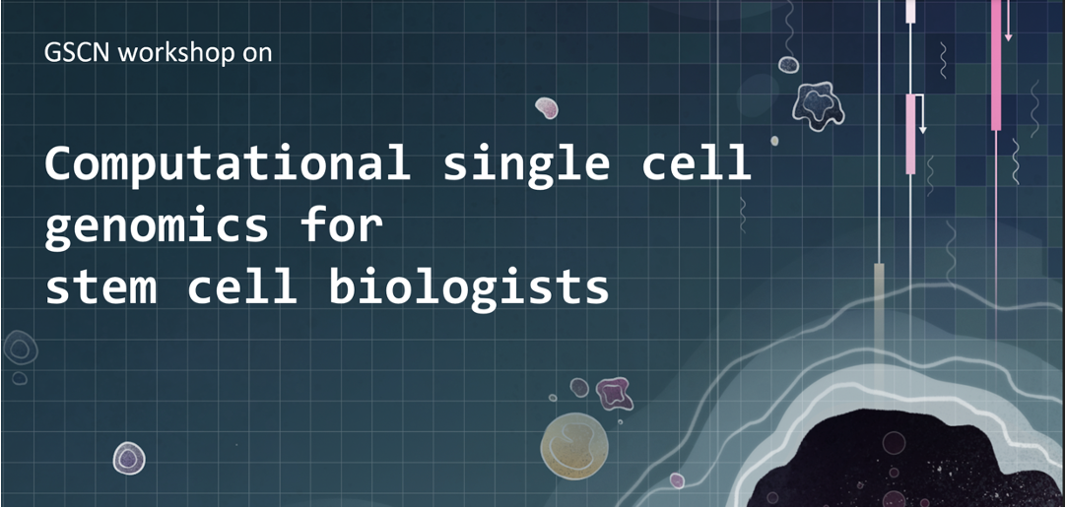
November 7 - 8

Slide 2






Computational single-cell genomics for stem cell biologists
Sara Jiménez
Machine learning group, CHC
November 8, 2024
sarajimenezc
sarajimenez

Slide 3
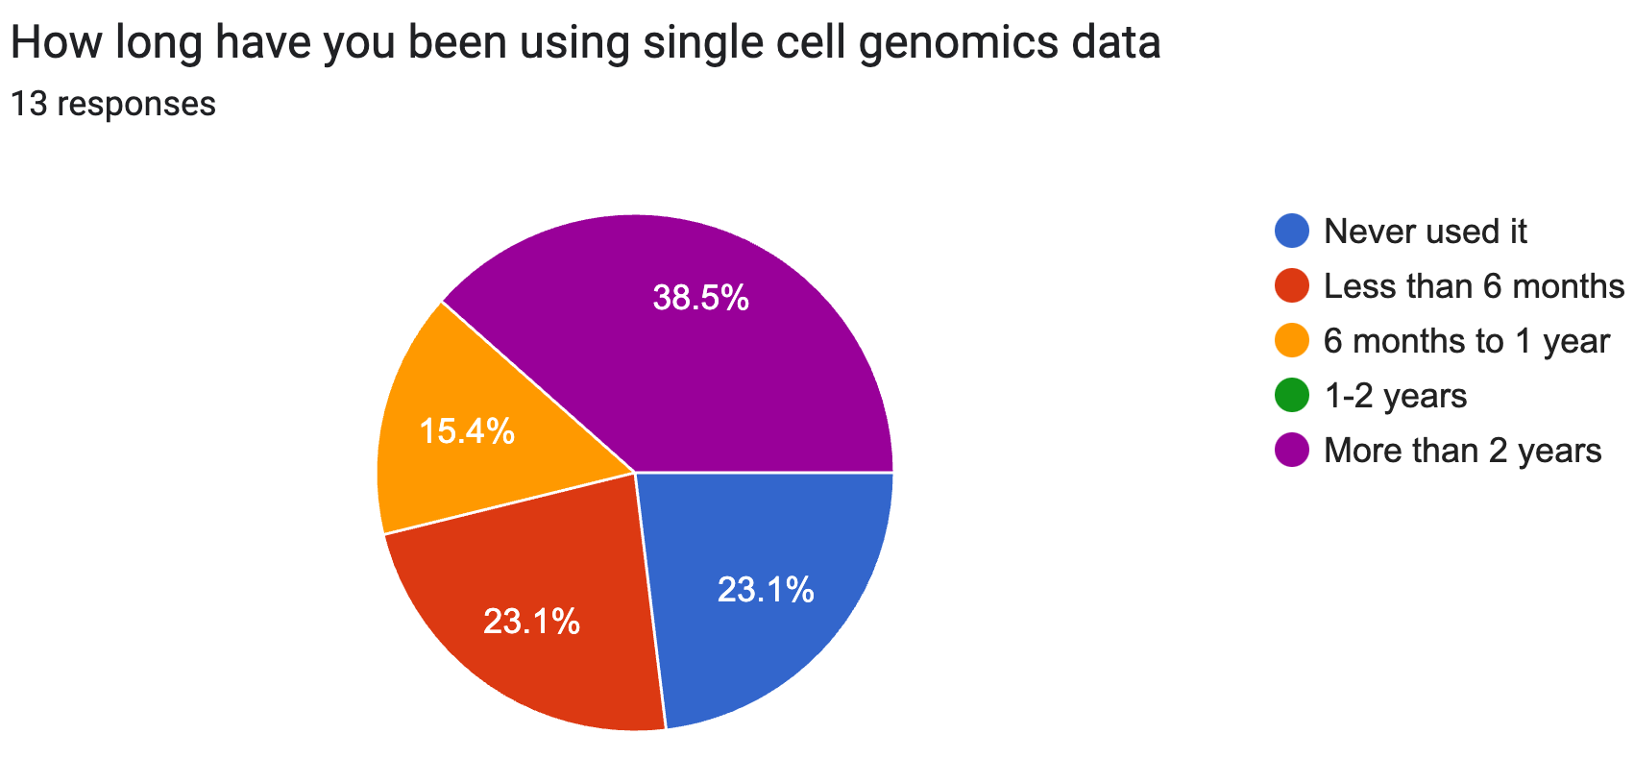
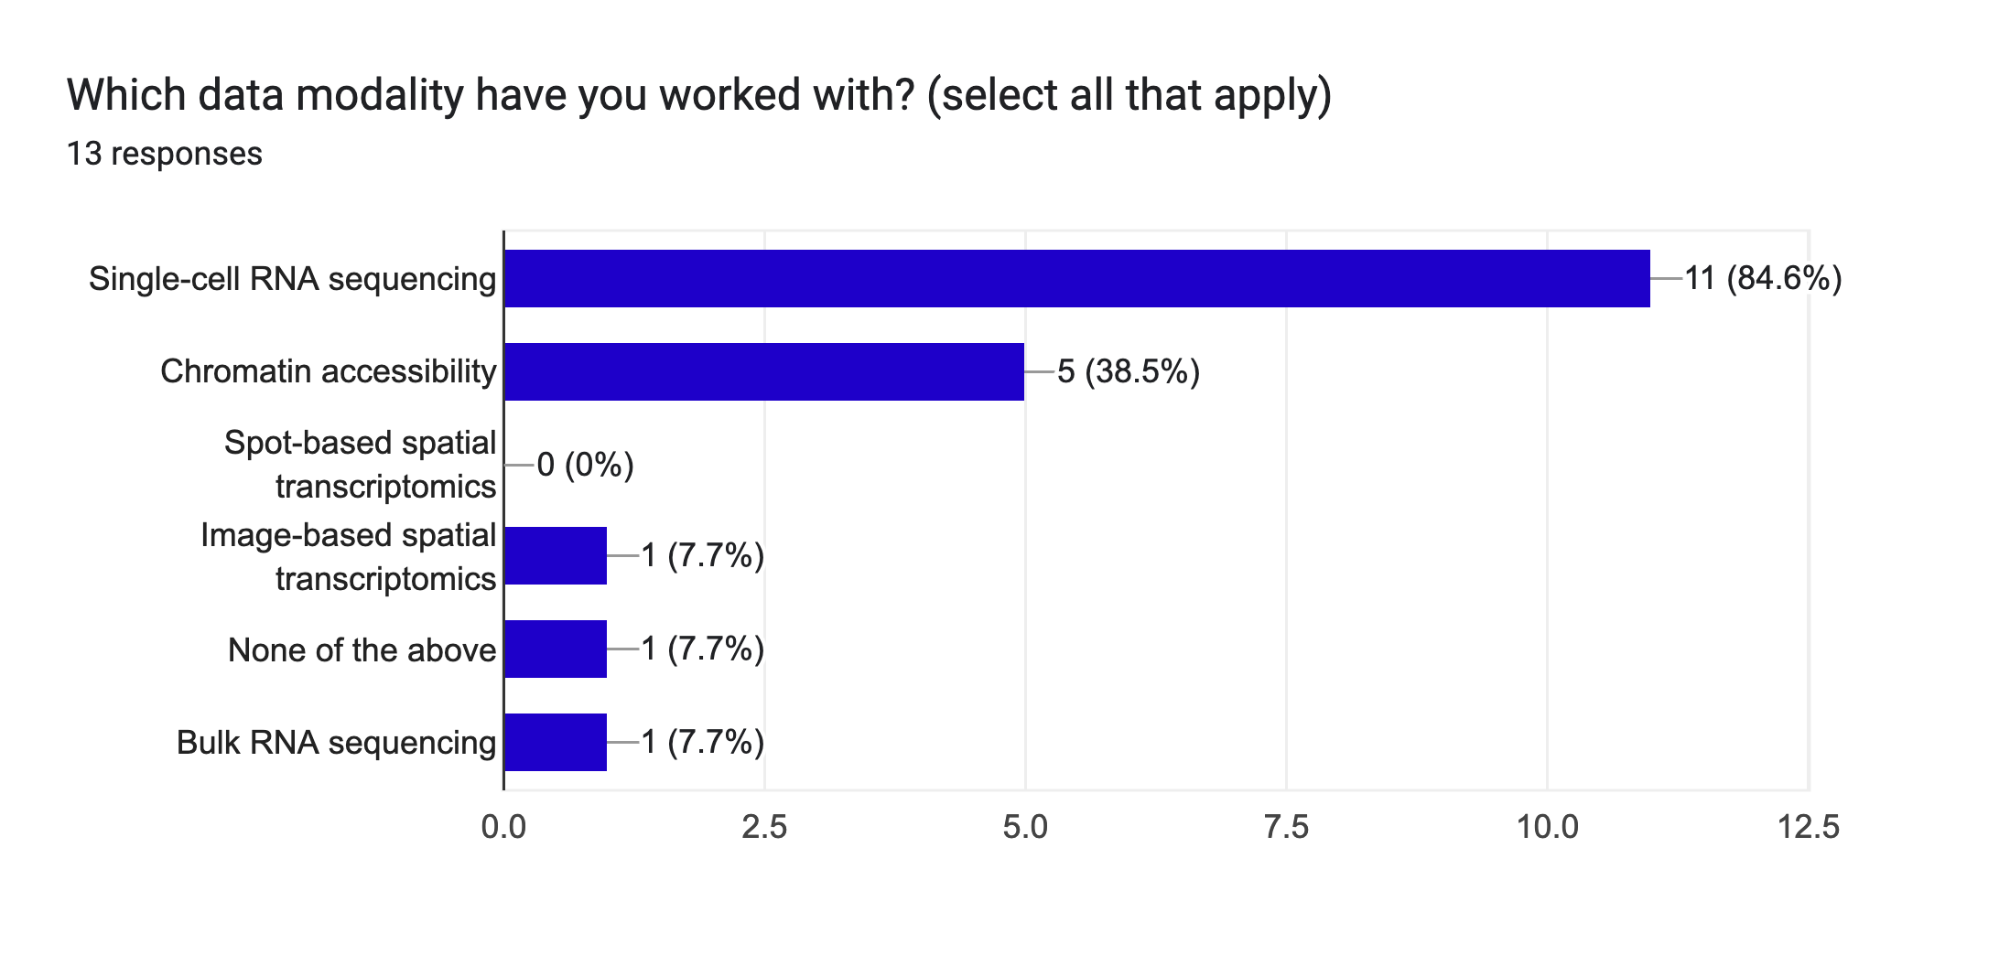
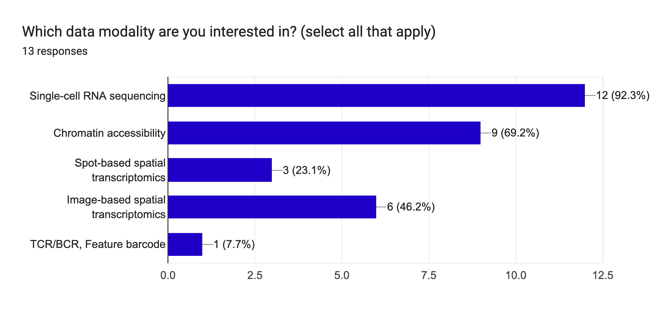
Overview of this workshop
Goals | To be careful about
Enable you to analyze scRNAseq data Introduce common set of computational tools to analyze single-cell RNA-seq data Focus on more complex analyses such as trajectory detection, batch effect correction Provide you with code/notebooks that you can adapt to analyze your own data: The code provided is only to serve as a guideline | Please do not consider the code/notebooks provided as being completely foolproof Your data will be different than the ones we will use in the workshop hence you will need to adapt the code or interpretations

Slide 4
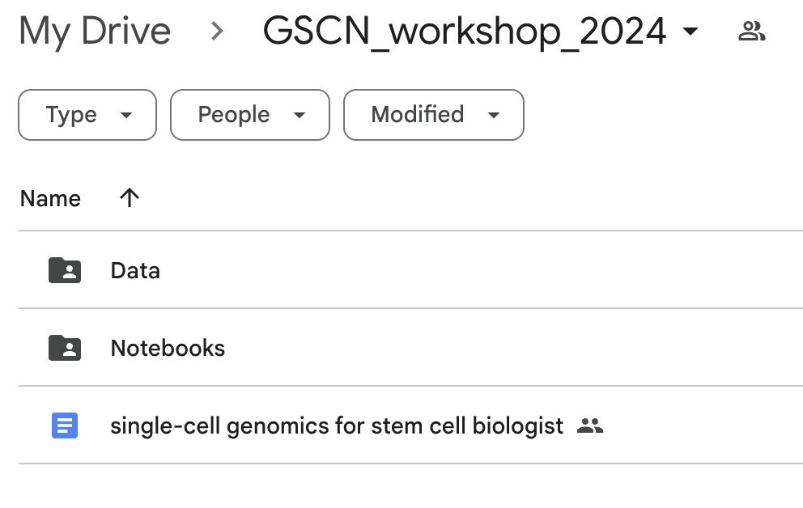
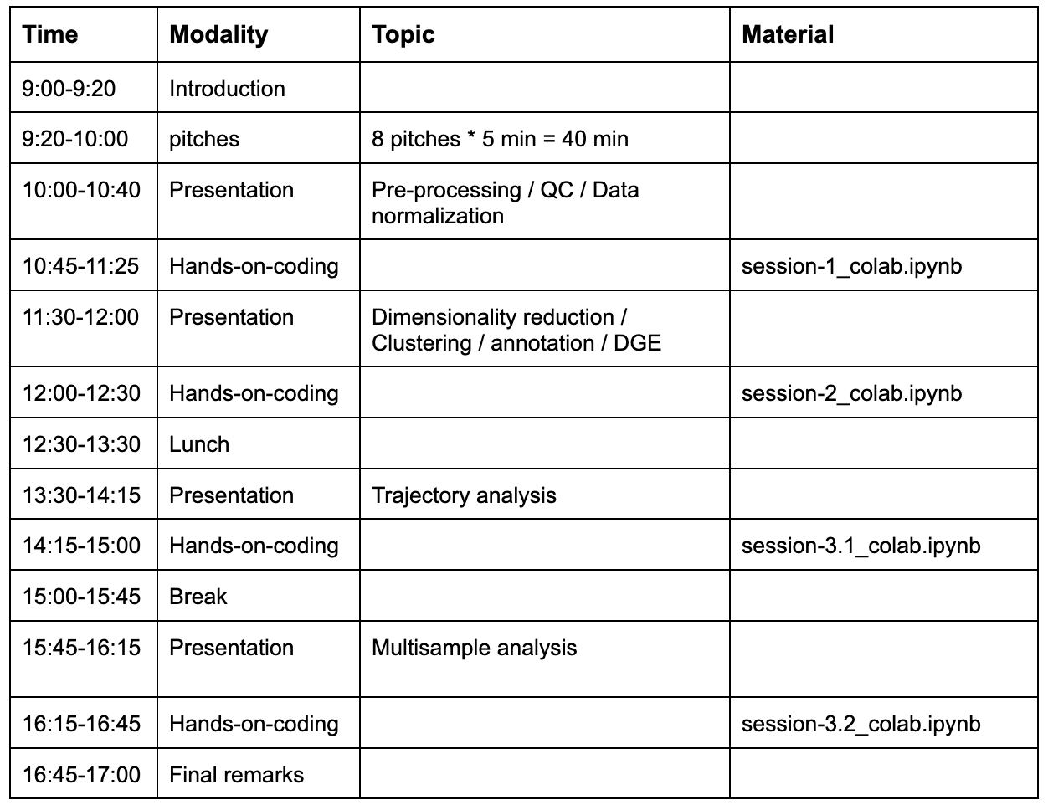
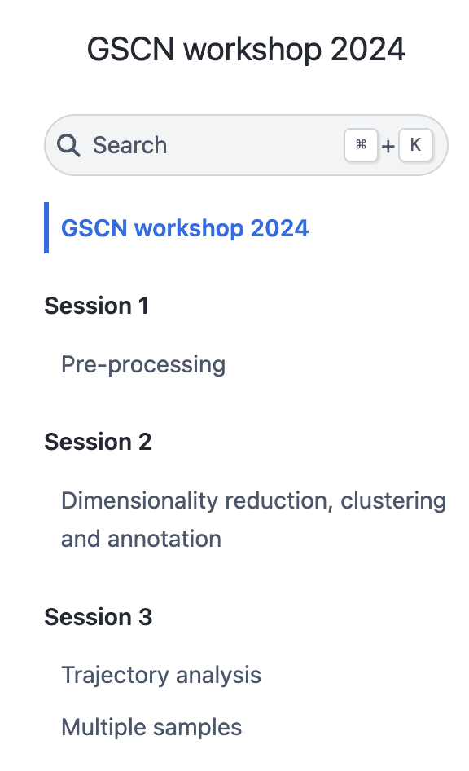
Overview of this workshop
https://sarajimenez.github.io/GSCN_workshop_2024/

Slide 5
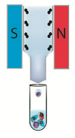
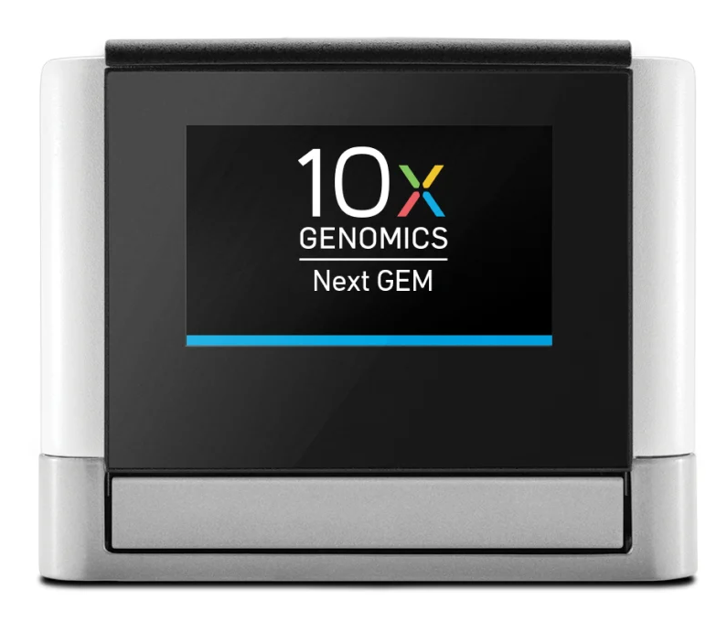
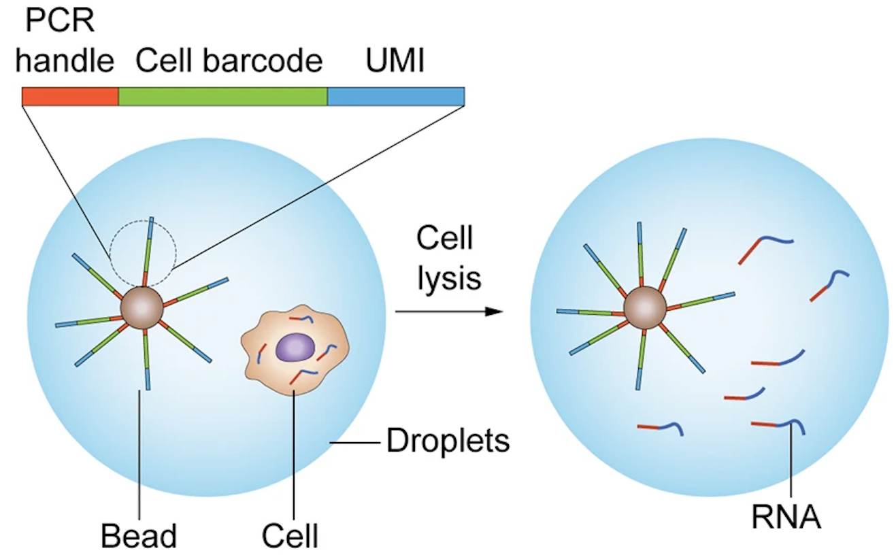
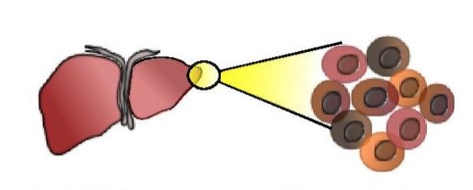
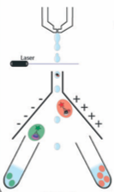
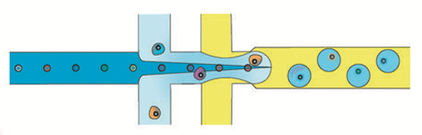
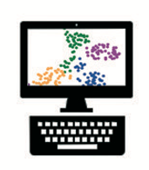
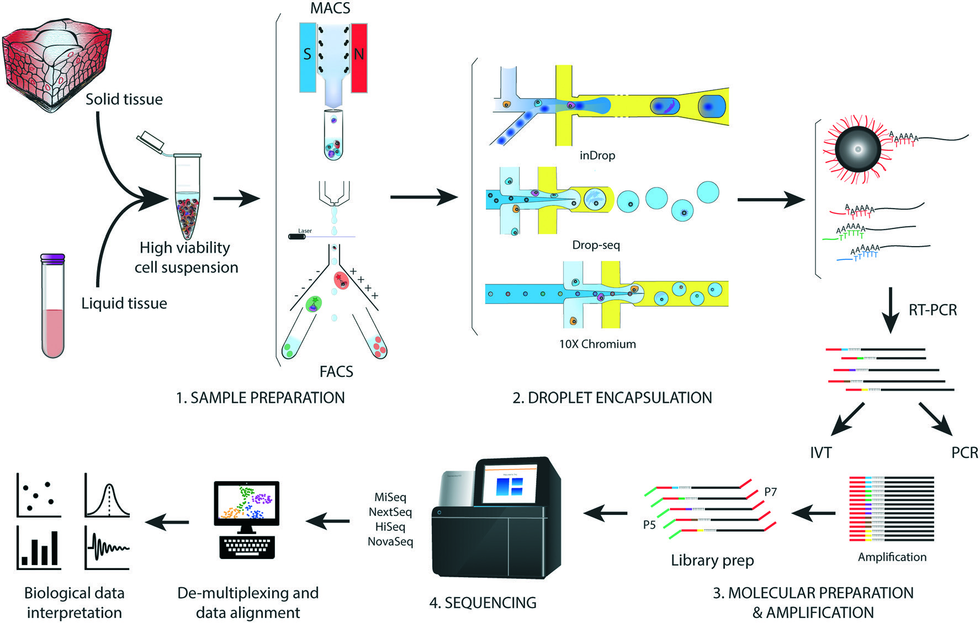
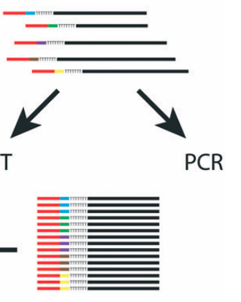
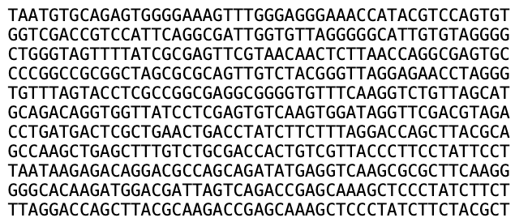
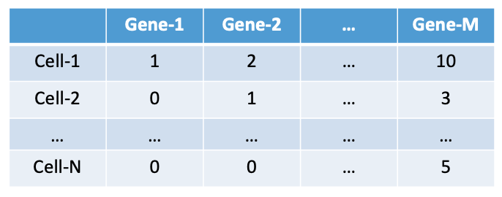

Single-cell RNA-sequencing data
Dissociation
Sorting
Single-cell Capture
Demultiplex,
Sequence Alignment,
Data Analysis
Dim-2
Sequencing
RT-PCR
Salomon, Robert, et al. Lab on a Chip (2019)
Dim-1
Goal: Familiarize and implement some outstanding computational tools used by the field
Notes:
scRNA-seq is an extremely powerful technique
Allows us to ask biological questions at an unprecedented level
Has already seen applications in numerous biological fields (embryogenesis, cancer, autoimmune diseases, neuroscience etc.)
Will play a major role in Human Cell Atlas
We are all very fortunate to have the opportunity to work with one of the transformative figures of such technology (Linas)

Slide 6
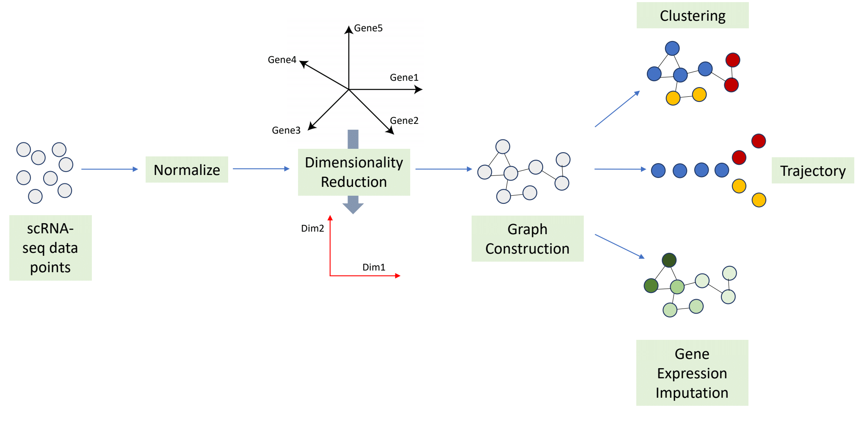
Single-cell RNA-sequencing data
Notes:
scRNA-seq is an extremely powerful technique
Allows us to ask biological questions at an unprecedented level
Has already seen applications in numerous biological fields (embryogenesis, cancer, autoimmune diseases, neuroscience etc.)
Will play a major role in Human Cell Atlas
We are all very fortunate to have the opportunity to work with one of the transformative figures of such technology (Linas)

Slide 7
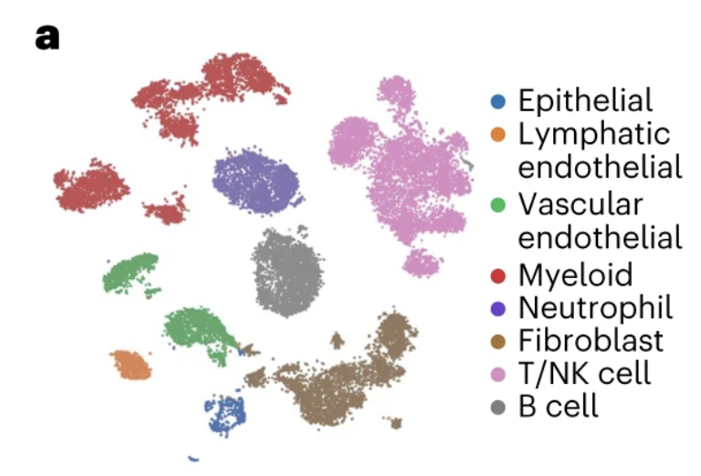
A general outline of analysis
Steps that go into producing a UMAP:
Combine data from each mouse
Library size normalize data
Feature selection of appropriate genes
PCA
K-nearest neighbor graph
UMAP
Assess batch effect
Clean data using marker genes
Repeat from step (2)
https://www.nature.com/articles/s41590-023-01504-2
Notes:
Explain the steps briefly. Tumor microenvironment cells in lung cancer
Given that there are so many steps involved, I think it is important that we spend some time going over each step and familiarizing with what could go right/wrong in each step. Therefore, I am not going to just simply give you code to do all these but try and spend some time talking about the different parameters, their importance for each step and how you can think of adapting the same arguments for your data.

Slide 8



Python and R for scRNA-seq data analysis
Python comes inbuilt for Macs
Can be managed and organized into environments through Anaconda/Miniconda distributions
Recommend: Use Anaconda to install Python and setup environments
Web application to create and share code, text, figures etc.
Notes:
In particular, the field of single-cell analysis has been relying on Python and R for analysis of RNA-seq data.
In this workshop, we will rely almost entirely on Python.

Slide 9

Python packages
Python packages are pre-written sets of code that one can simply “load” or “import” onto Jupyter Notebook
Packages we will rely on mostly:
Numpy: Working with arrays, matrices
Pandas: Working with data frames
Matplotlib: Plotting functions
Seaborn: Additional plotting functions
Scanpy: Package developed for single-cell data analysis
Highlights:
scanpy contains Python implementation of the most widely used single-cell RNA-sequencing methods (Data Normalization, PCA, tSNE, UMAP, Diffusion Maps, trajectory inference, batch correction etc.)
Developed in Theis’ Lab by Alex Wolf - Wolf et. al. Genome Biology. (2018)
A lot of help available online: https://scanpy.readthedocs.io/en/stable/

Slide 10
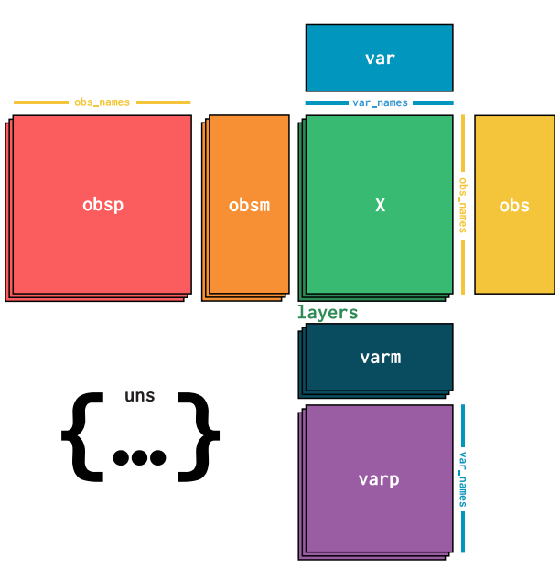
Anndata structure
Easy way to track all data/metadata
Effective when one gets deep into data analysis and meta data start accumulating
Each row corresponds to the same cell
scanpy uses the annotated data structure
(https://anndata.readthedocs.io/en/latest/index.html)
Each column corresponds to the same gene

Slide 11
Example scRNA-seq data: 10X Cell Ranger

Slide 12
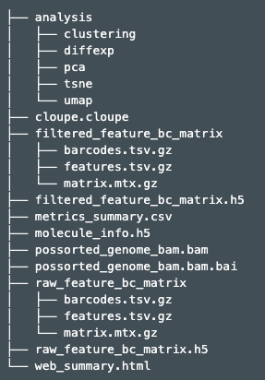
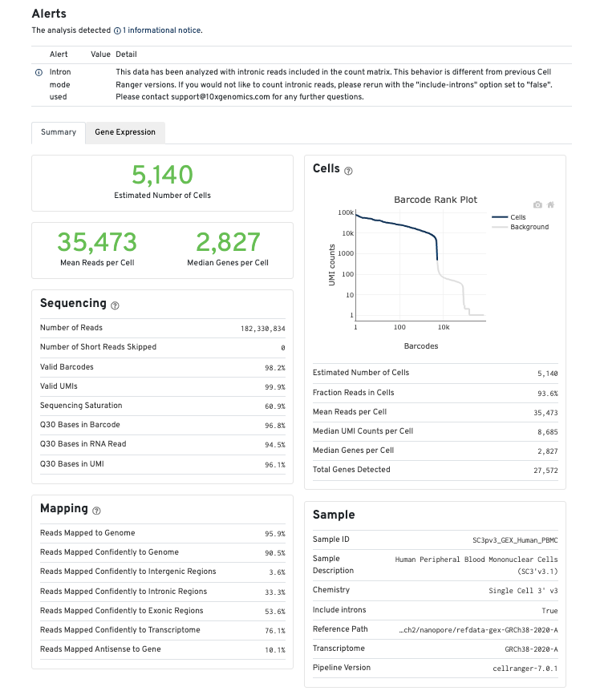
10X Cell Ranger output – web summary

Slide 13
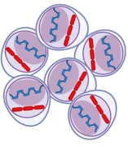
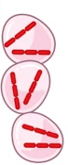
10X Cell Ranger output
Recommend to use this data
Droplets with real cells
Filtered data with empty droplets identified and removed using EmptyDrops method
Raw data with every single droplet that was sequenced
Droplets possibly with floating mRNA but no real cell
https://genomebiology.biomedcentral.com/articles/10.1186/s13059-021-02547-0

Slide 14
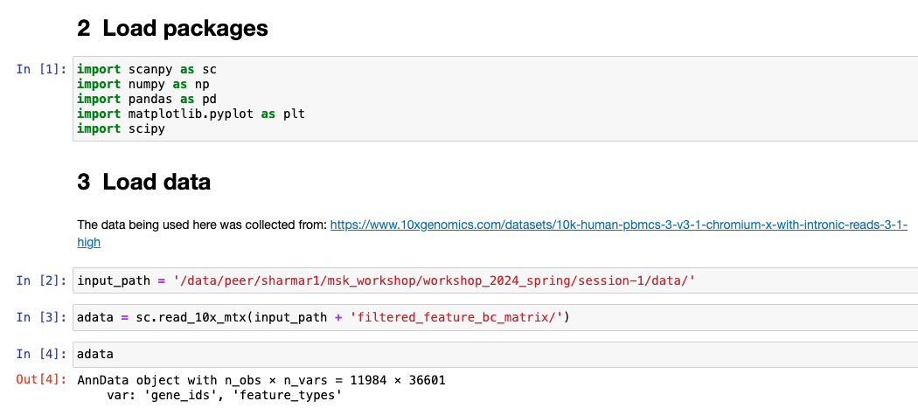
Load data onto Scanpy - example
Number of cells
Number of genes
Other attributes like obsp, obsm, varm etc will be added as the analysis progresses.

Slide 15
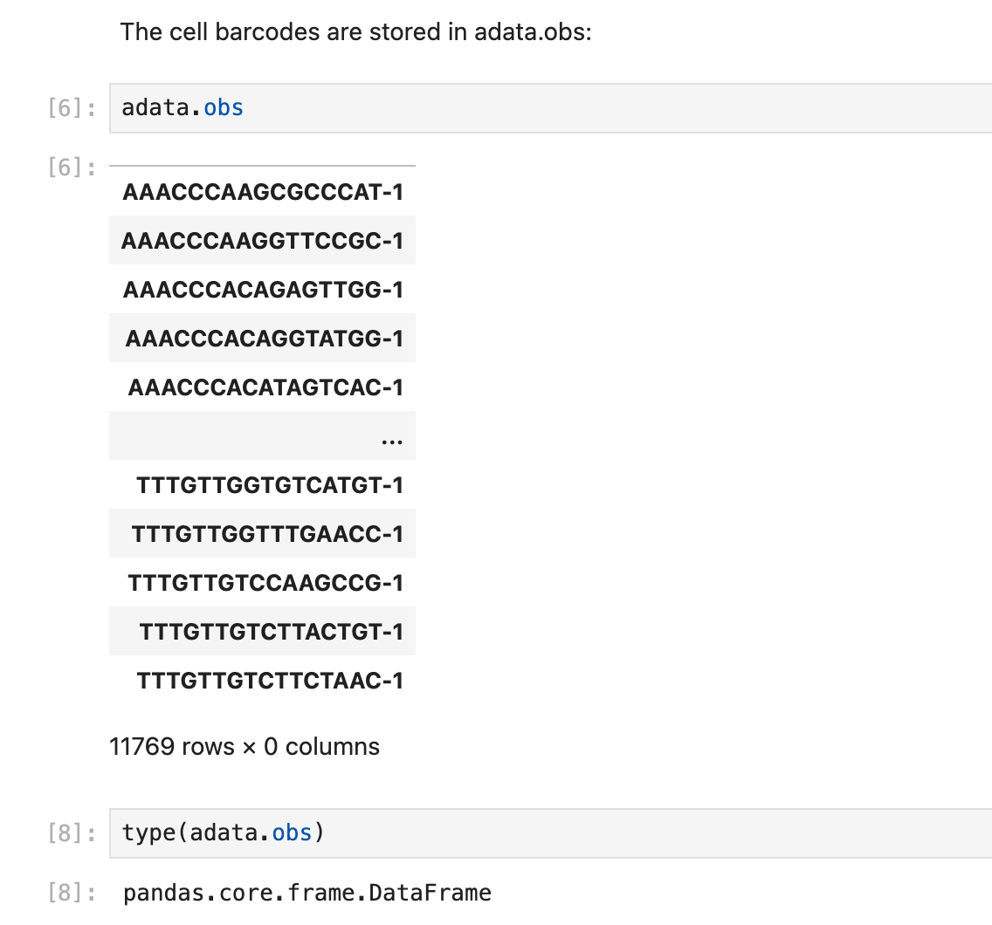
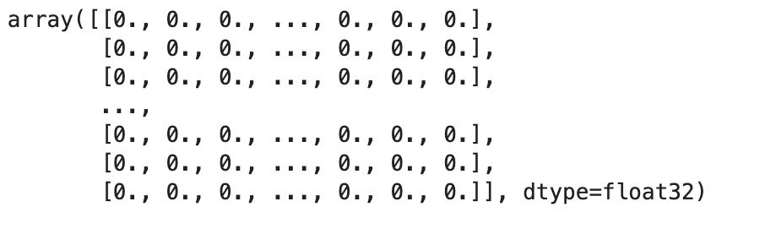
Load data onto Scanpy - obs

Slide 16
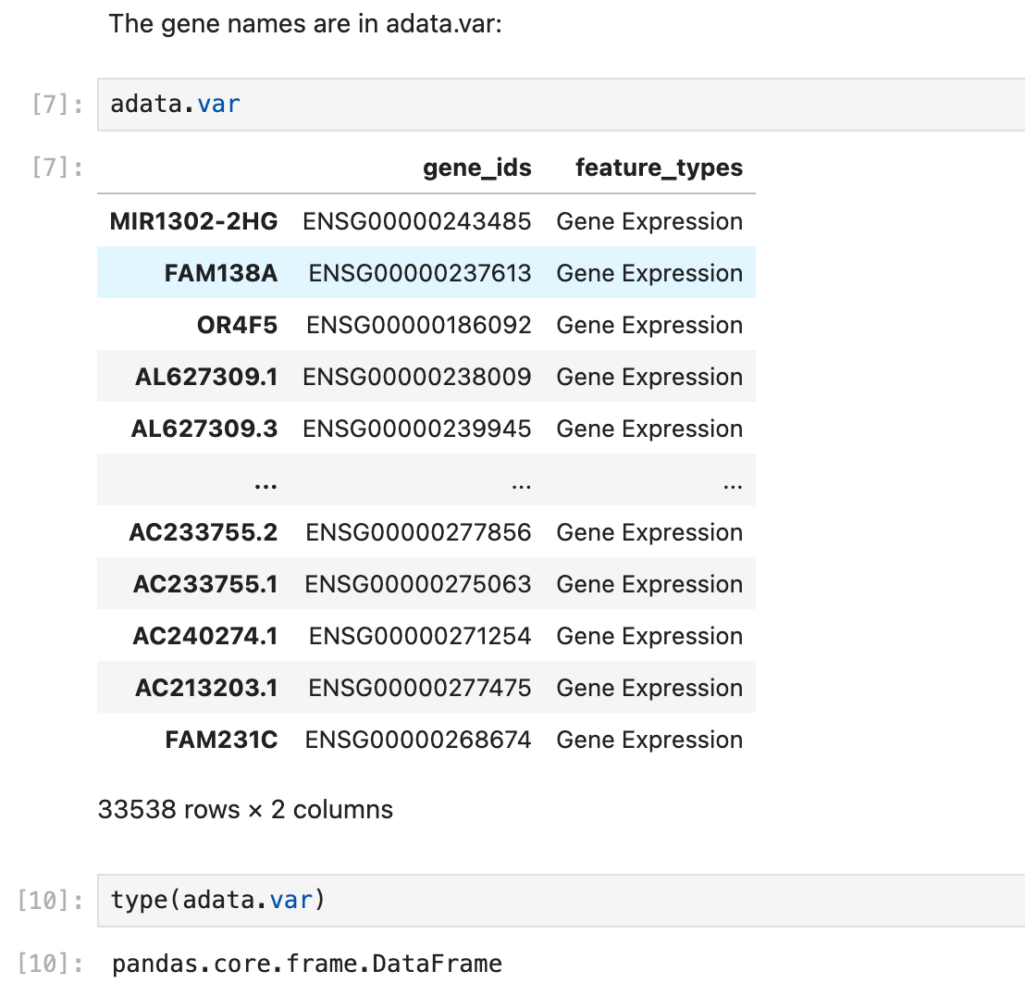
Load data onto Scanpy - var

Slide 17
Processing single-cell RNA-sequencing data

Slide 18
Processing single-cell RNA-sequencing data
scRNA-seq data matrix
Pre-process and QC
Data Normalization
New version of CellRanger implements EmptyDrops (Lun et al.)
Identifying Empty droplets (ambient RNA)
Library size distribution; Number of cells each gene is expressed in
Downstream analysis
Mitochondria or ribosomal expression
Number of uniquely expressed genes per cell

Slide 19
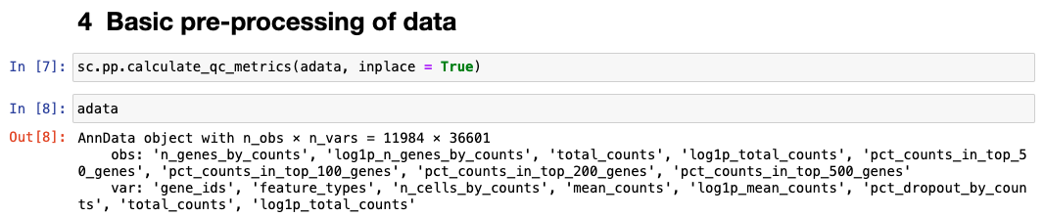
Pre-processing and QC of the data
Automatic QC metrics from scanpy. For more details, see:
https://scanpy.readthedocs.io/en/stable/generated/scanpy.pp.calculate_qc_metrics.html

Slide 20
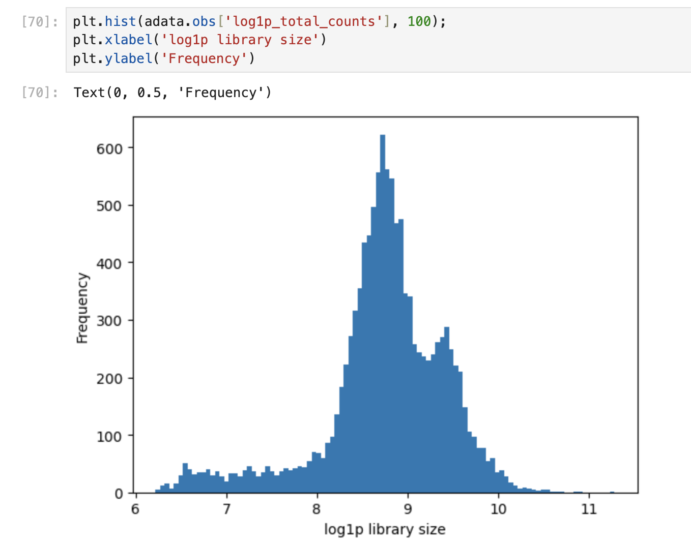
Library size distribution
General insights one can draw from this figure:
On average, the library size or total RNA counts per cell is quite high (mean is ~8.5, which equals ~4000 transcripts). Typical is around 1K-2K transcripts.
There are some cells with a bit lower counts (<7 on log scale which is less than 1000 transcripts). Could these be low quality cells? This needs to be kept in mind for downstream analysis.
There appears to be some bimodality in the distribution. Could this imply that there are different cell types in the data with different library sizes?

Slide 21
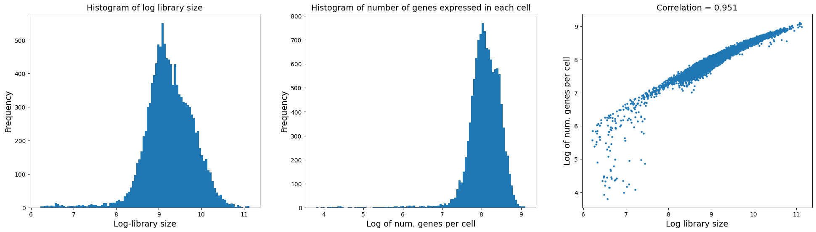
Pre-processing and QC of the data
The scatter plot on the right however suggests that there are some cells with low number of genes expressed but have a decent library size.
These cells are likely low quality and should likely be removed. We have two options:
Remove them now: [sc.pp.filter_cells(data, min_counts=None, min_genes=None, max_counts=None, max_genes=None, inplace=True, copy=False)] sc.pp.filter_cells(adata, min_genes = np.exp(6))
Remove them after some downstream analysis

Slide 22
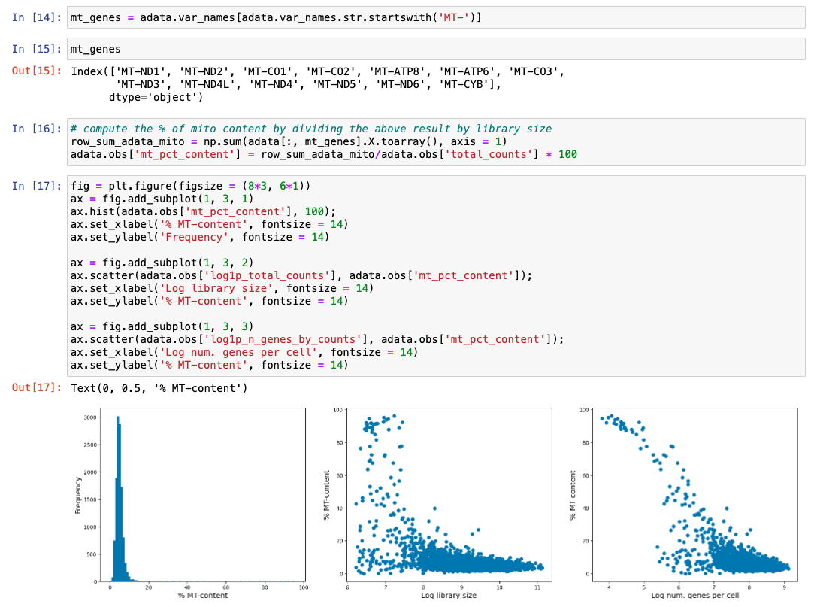
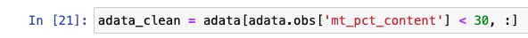
Pre-processing – mitochondrial content
The presence of high mitochondrial gene expression can indicate cells undergoing apoptosis.
A typical step in scRNA-seq analysis is to remove cells with high mitochondrial RNA expression.
Question: Should we be doing this from the beginning itself?
=> In majority cases it may be important to remove them from any analysis as they can corrupt co-variance in the data. However, if you want to study cells under apoptosis then you should not do this.

Slide 23
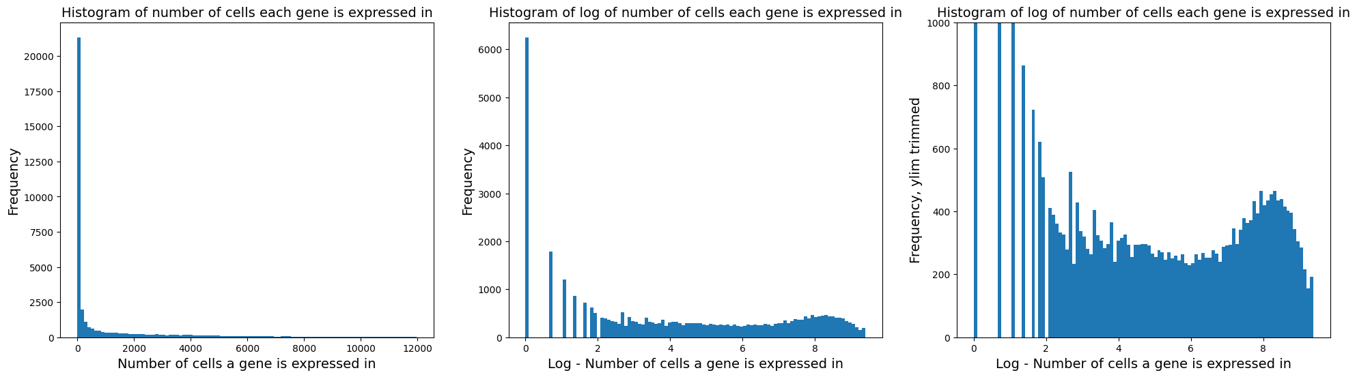
Pre-processing and QC of the data
Check the distribution of number of cells each gene is expressed in
Based on the distribution, we see many genes expressed in 0 or low number of cells. Questions to ask ourselves:
Can I remove genes expressed in very few cells? Generally, yes but context is always important. E.g.: data with different conditions where a gene may be perturbed compared to control.
In current scenario, we can remove cells expressed in less than a handful of cells (red line above)

Slide 24
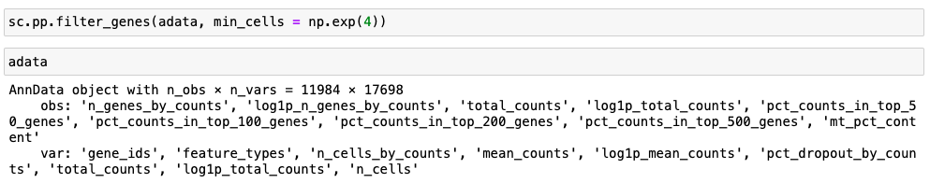
Pre-processing and QC of the data
Number of genes reduced from ~33,000 to 13,730

Slide 25
Data QC - Summary
Data QC does not always imply we want to forcefully clean data
We want to see if there are red flags
If the flags are obvious, we can remove them. Else, we keep the flags in mind while we analyze the data downstream and clean data later using additional (biological) reasoning
By doing basic QC we get a “feel” for the data
Additional QC metrics:
Study ribosomal content like we did for mitochondrial content
Use advanced tools such as CellBender to correct gene expression counts

Slide 26
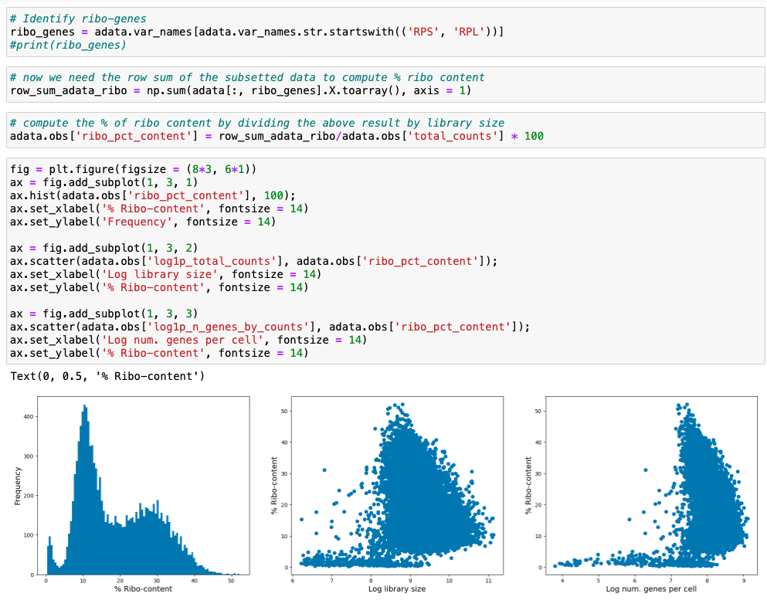
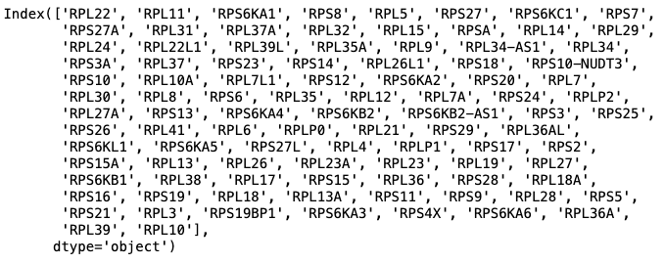
Data QC – (Ribosomal content)

Slide 27
Post data pre-processing: - Data normalization - Highly Variable Genes - PCA - Nearest Neighbor Graph - Visualization, Clustering

Slide 28
Data normalization
Library size normalization:
To correct for total mRNA count (biases due to sequencing depth) that may be driving cell-cell heterogeneity
Often the variance in cells seems to be driven largely by sequencing depth differences, which is not necessarily biologically relevant.
Most common method: Median library size normalization + log transformation
Inspired by TPM normalization in bulk data analysis
Assumes all cells should have the same total mRNA count, not always a good assumption
Other statistically principled tools:
Scran (https://genomebiology.biomedcentral.com/articles/10.1186/s13059-016-0947-7)
Sctransform (https://genomebiology.biomedcentral.com/articles/10.1186/s13059-019-1874-1)

Slide 29
Data normalization – Method 1 (Median library size + log transformation)
Step 1:
Step 2:
$$Normalized cell expression= \frac{raw cell expression}{total RNA counts}× Median total RNA counts across cells$$
Scaling constant
$$Normalized cell expression=log⁡(Normalized cell expression+1)$$
Pseudocount to ensure 0 raw counts stay as 0.

Slide 30
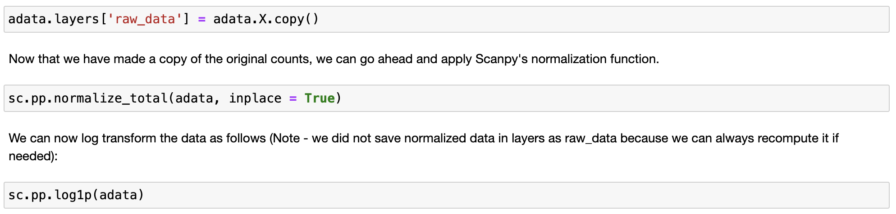
Data normalization – Method 1 (Median library size + log transformation)

Slide 31
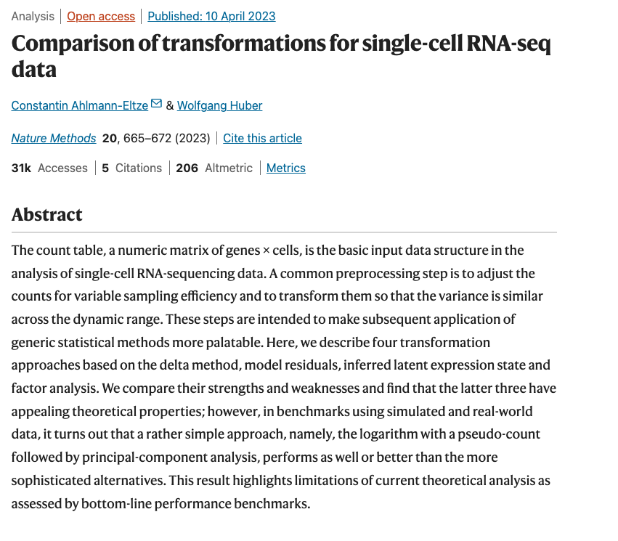
What normalization method to use?
Recommendation:
Median library size normalization + log is the default in the field
Scran can be a good alternative if you expect to have cell types with very different library size distribution in your data

Slide 32
Questions?
Hands-on-coding

